Slide 1
Sisters, Servants of the Immaculate Heart of Mary

Slide 2
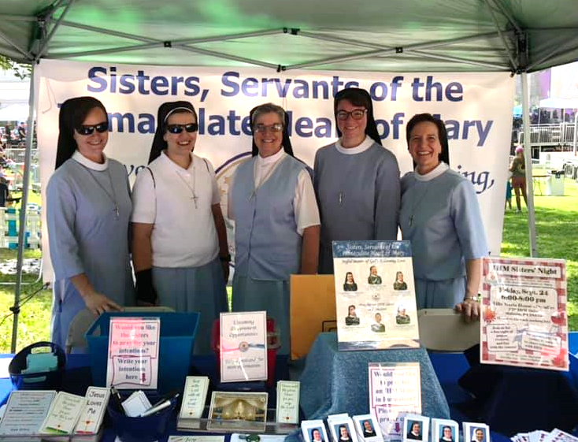

Slide 3
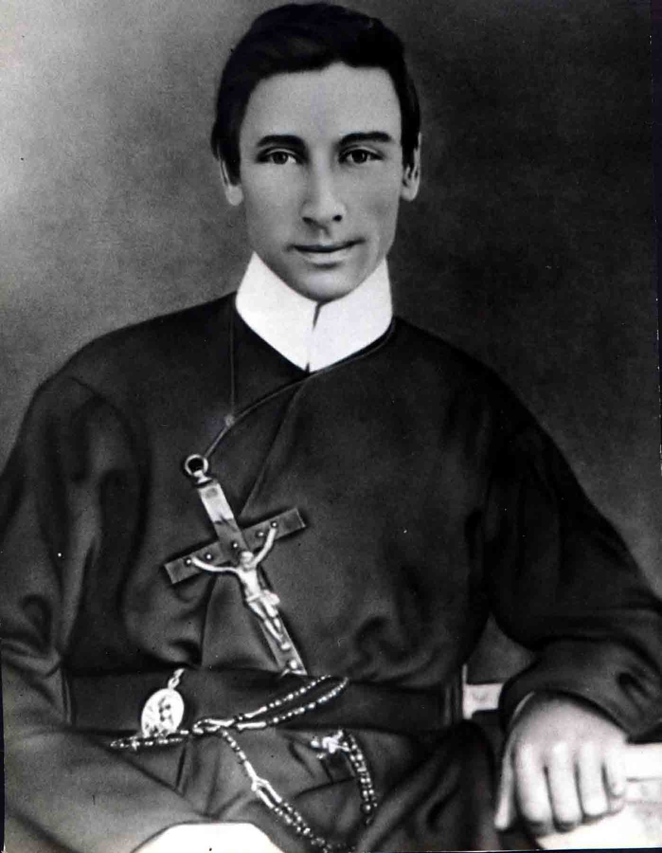
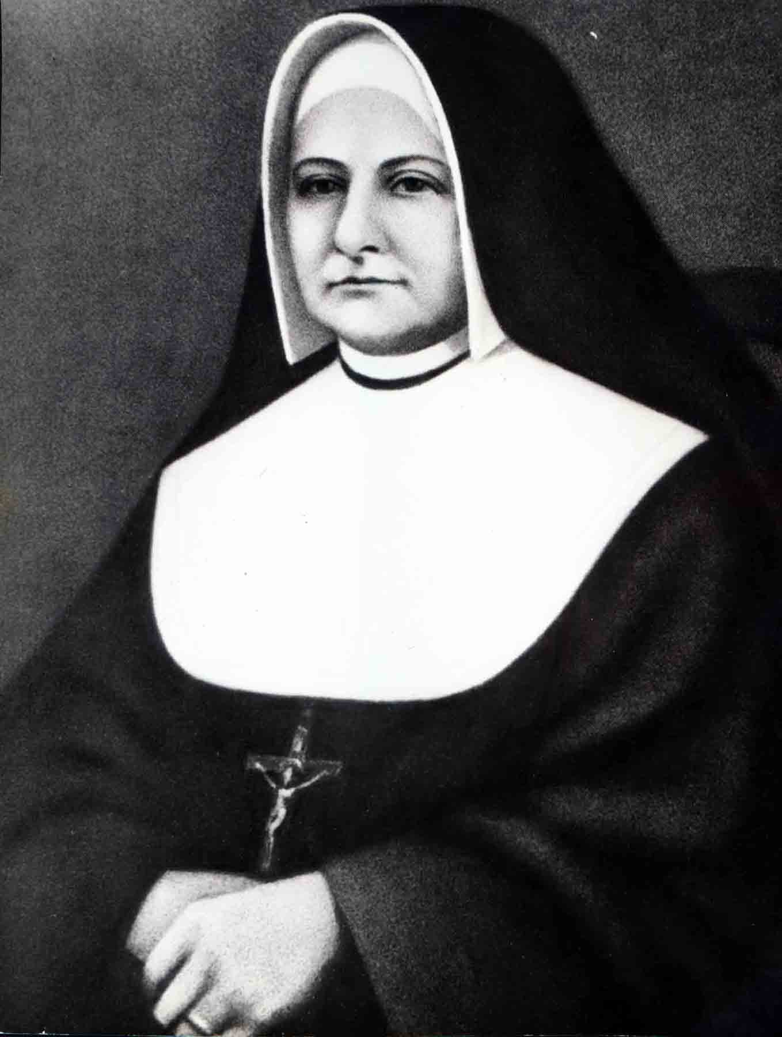
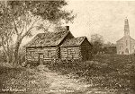
Mother
Theresa
Maxis
Father Louis Florent
Gillet, CSSR
Monroe, Michigan, 1845

Slide 4
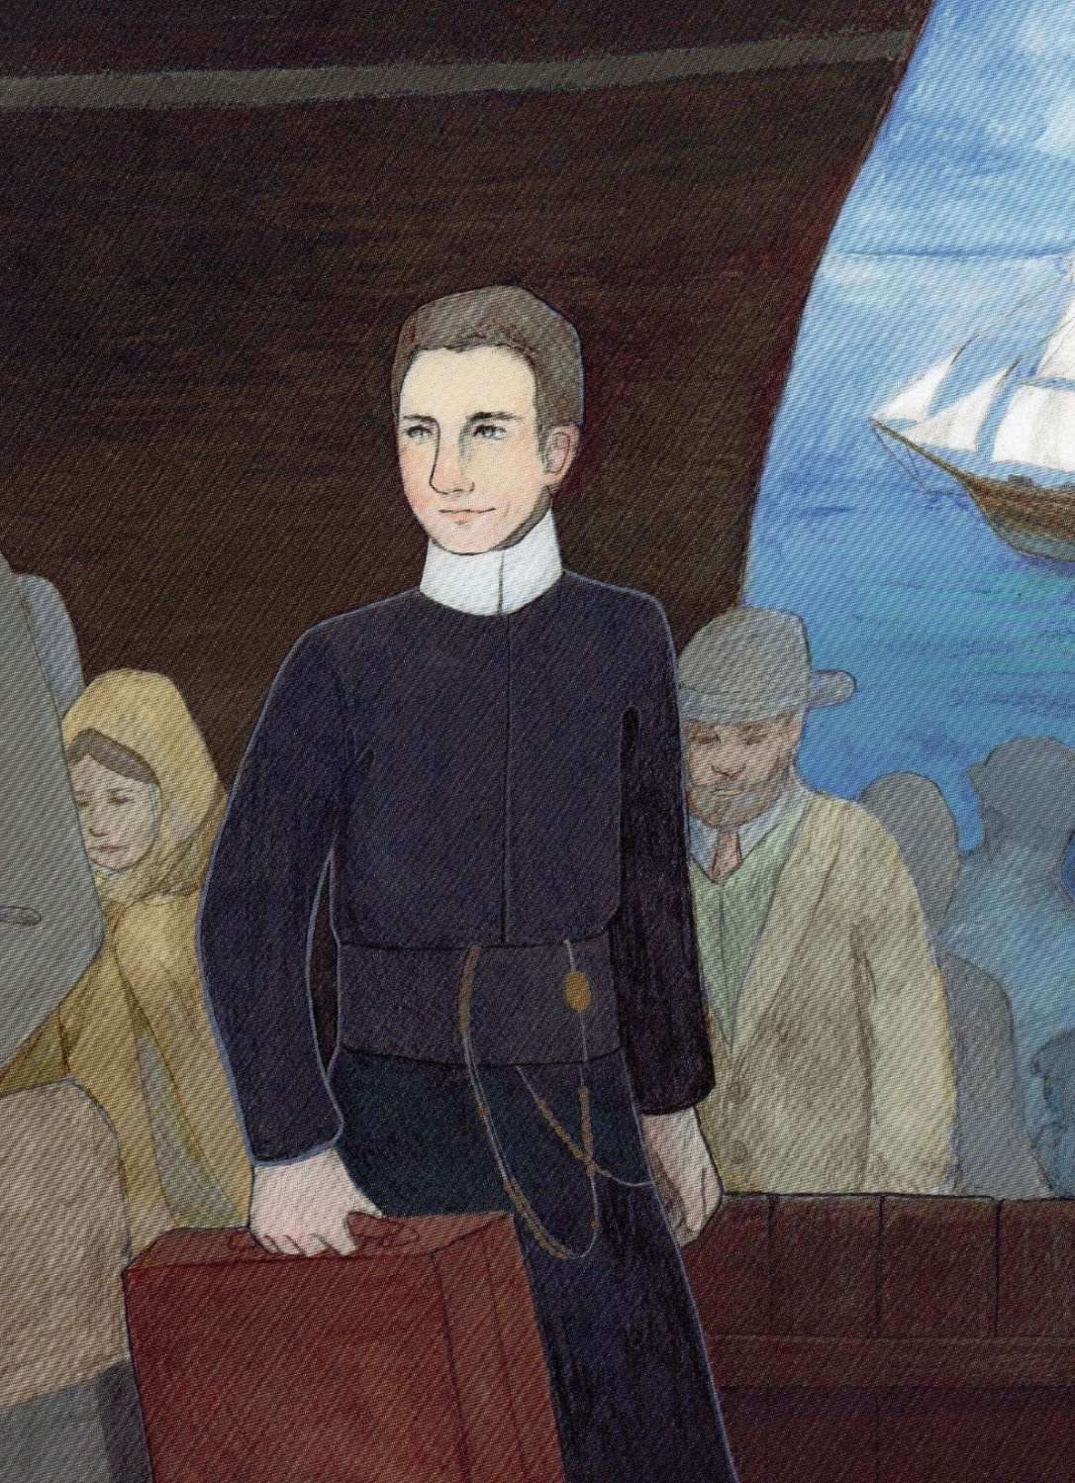
Father Louis Florent Gillet
1833 became
Redemptorist priest
Missionary in the USA

Slide 5
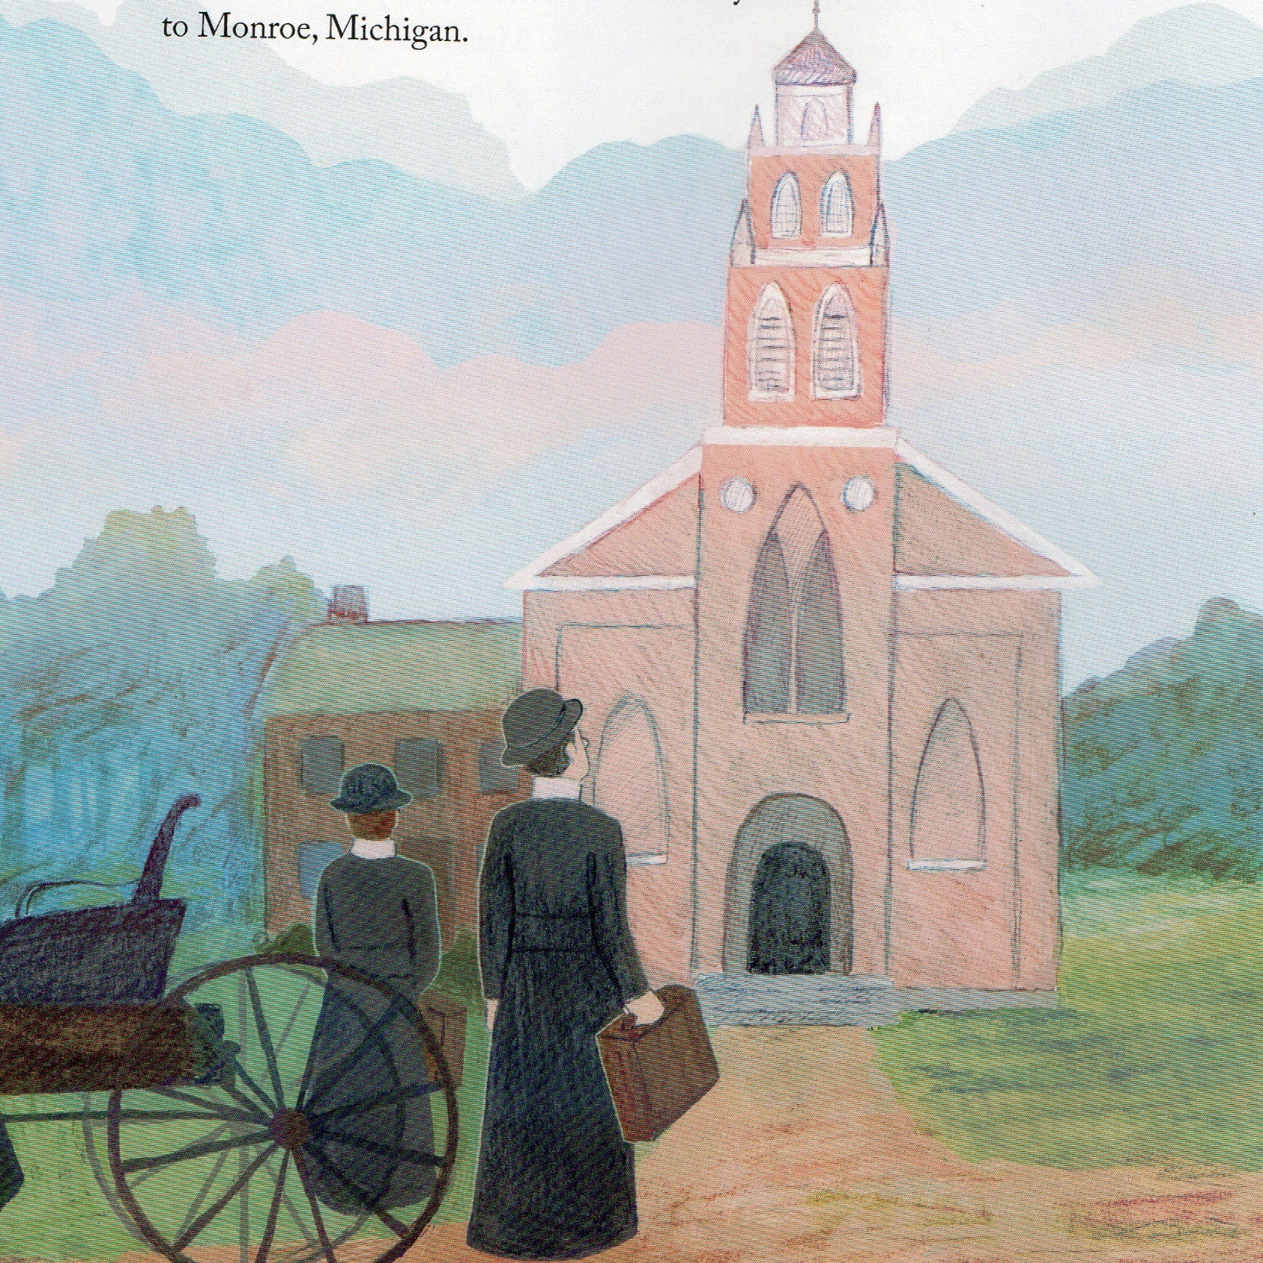
Monroe, Michigan
1843

Slide 6
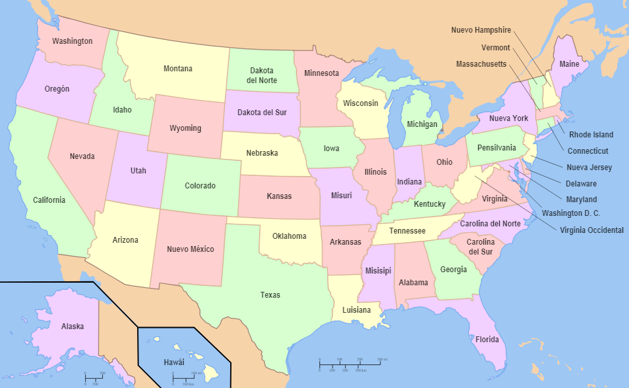
Canada
.
Monroe

Slide 7
Father Louis Florent Gillet, C.Ss.R.
Missionary
Founder

Slide 8
Mission
Enthusiasm
Energy
Vitality
Love for God and
his people.

Slide 9
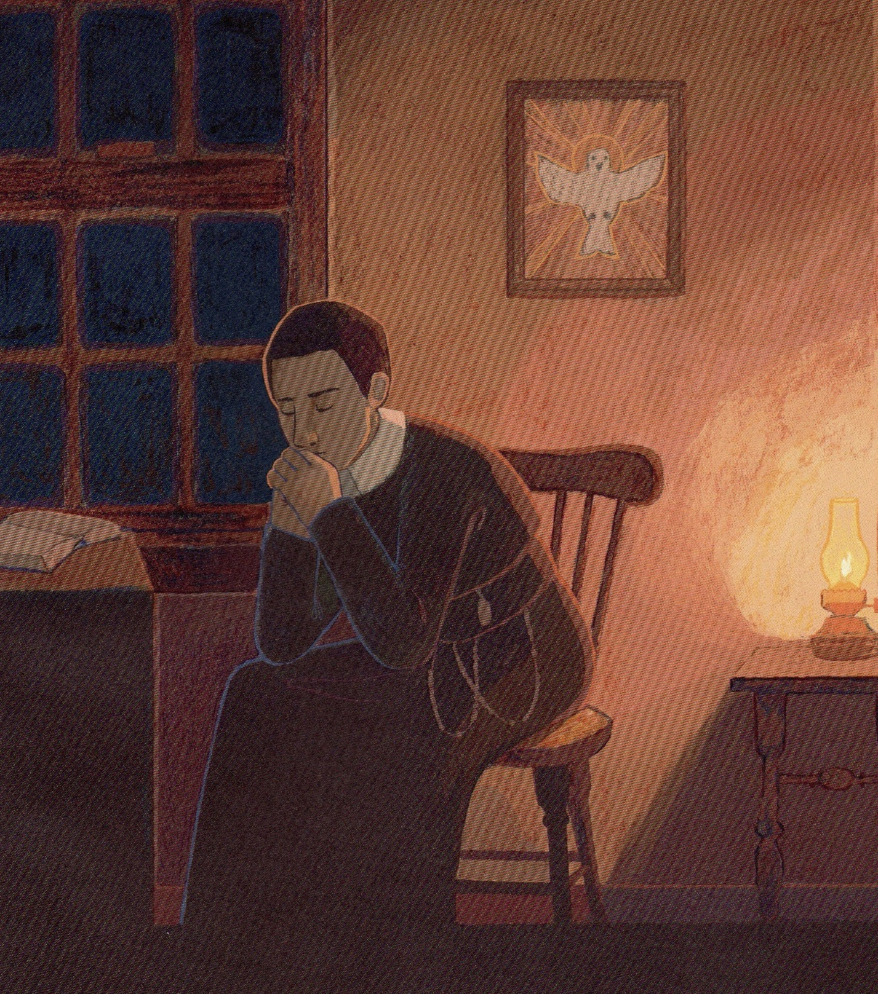
Please, God, send me Sisters who have the same enthusiasm to teach the children and prepare them for the Sacraments. I need help. Thank you for hearing my prayer.

Slide 10
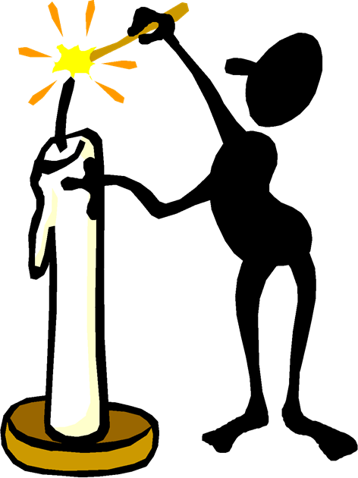
If I can´t find a community I´ll organize one.
Thank you, Lord for the inspiration.

Slide 11
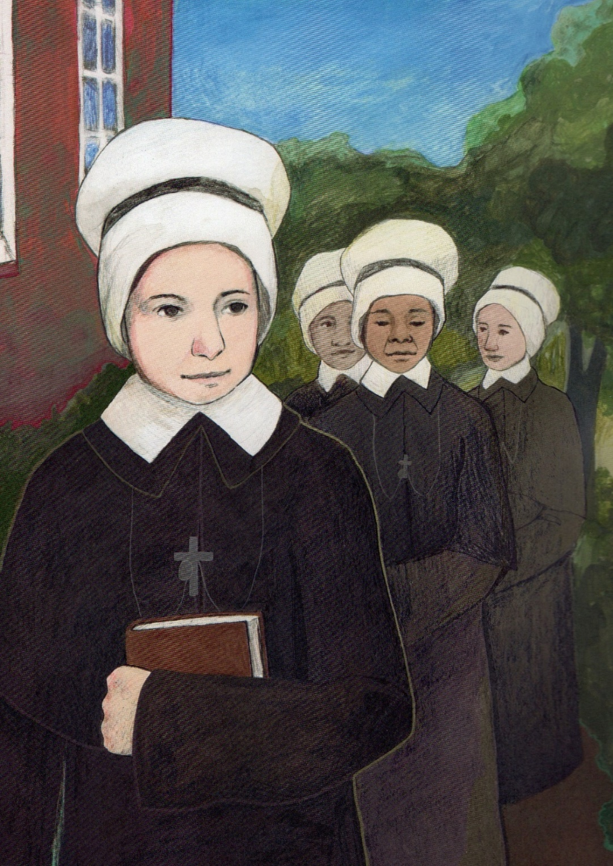
Mother Theresa Maxis
Mother Theresa Maxis was born in Baltimore, Maryland.
In 1829 she was a boarding student with the Oblate Sisters and became one of them.
She met Father Gillet when he came to say Mass in the convent. She shared his enthusiasm for the mission and loved hearing his stories of his missionary work in Michigan.

Slide 12
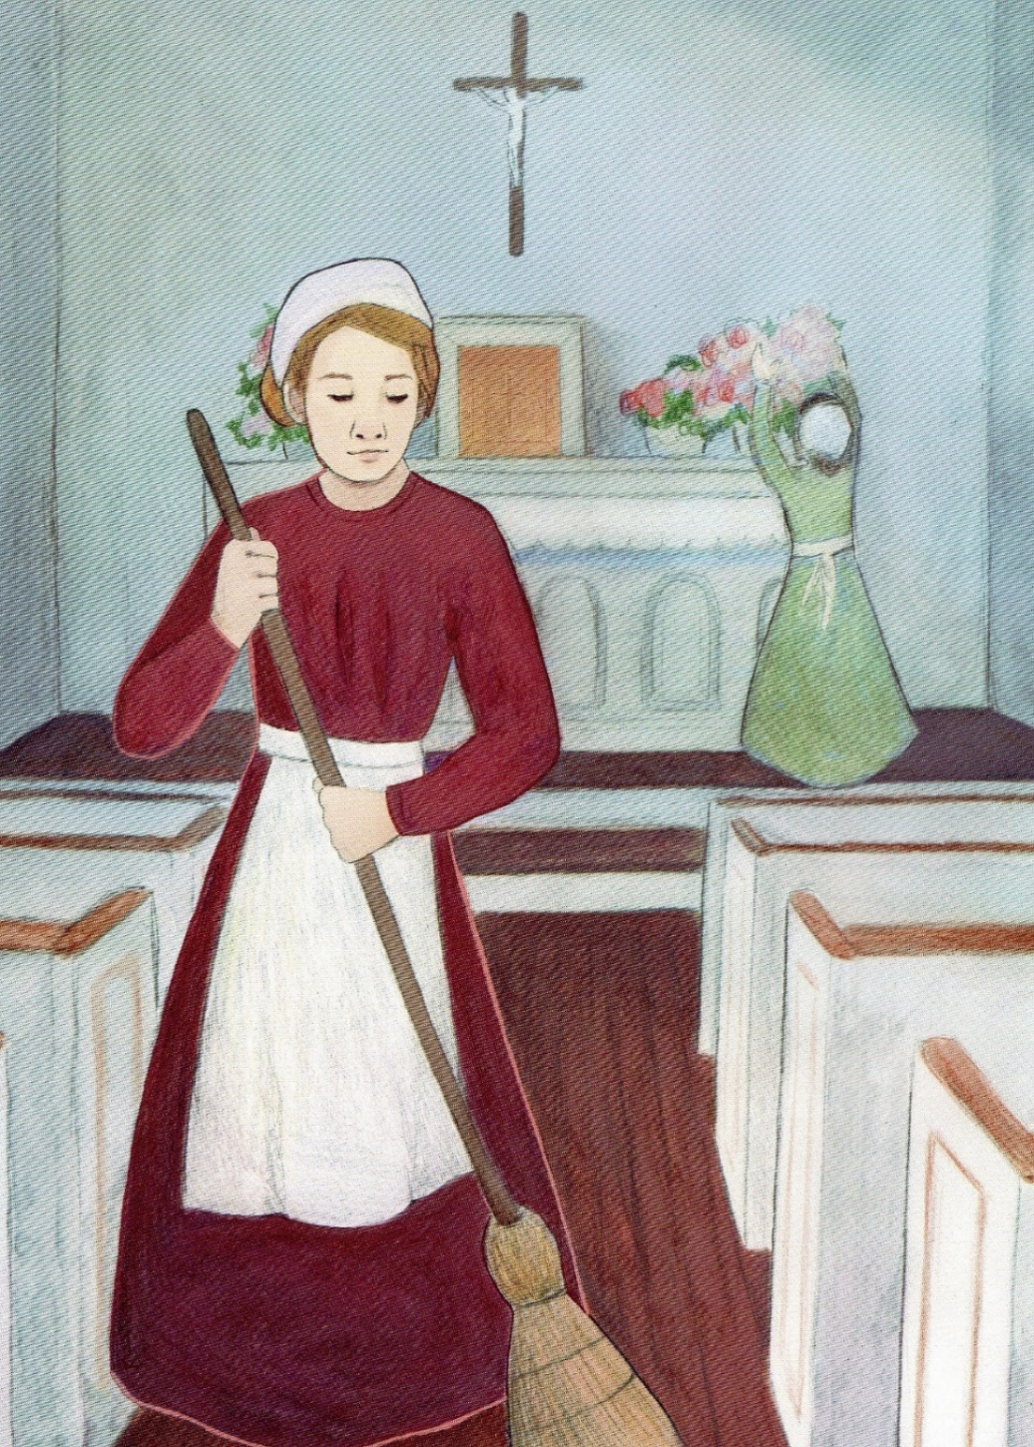
Therese Renauld
Father Gillet recognized that she had all that was necessary to be a sister. She loved helping the people and she gave service cleaning the church and ringing the bells to tell the people that Mass was going to begin.
Father talked to her and she realized that she wanted to be a sister but didn´t know how to express it. She prepared her heart to become part of the small community.

Slide 13
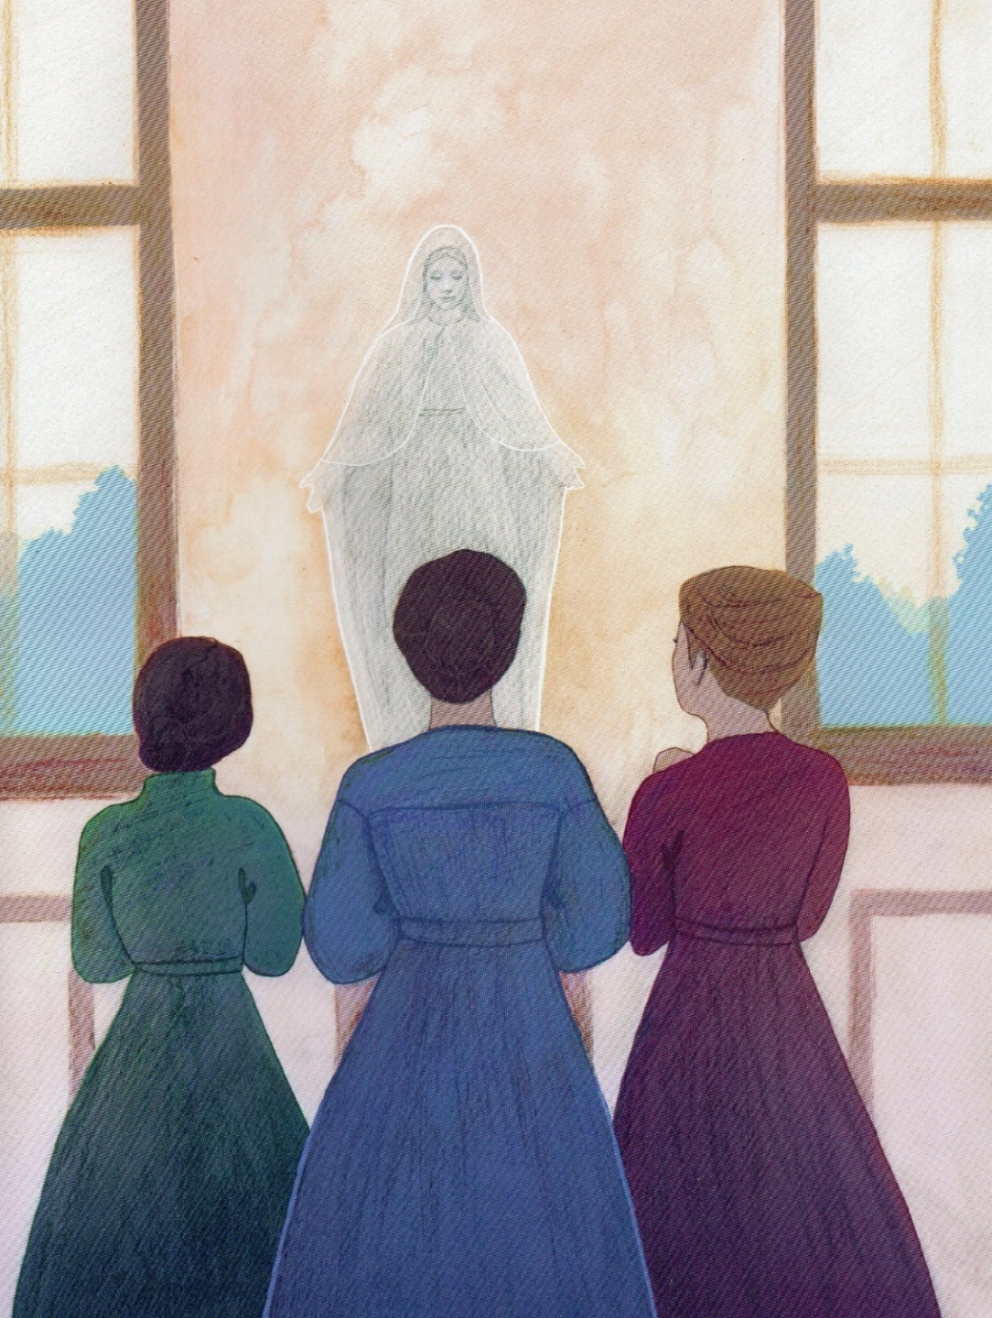
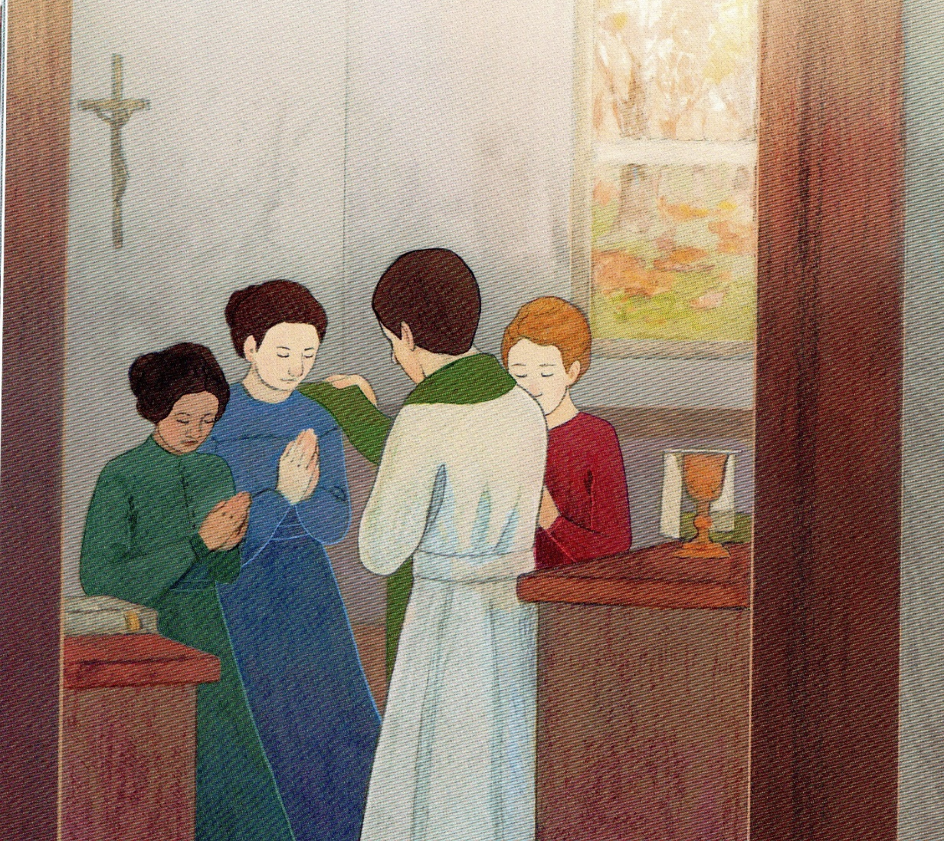
November 10,1845

Slide 14
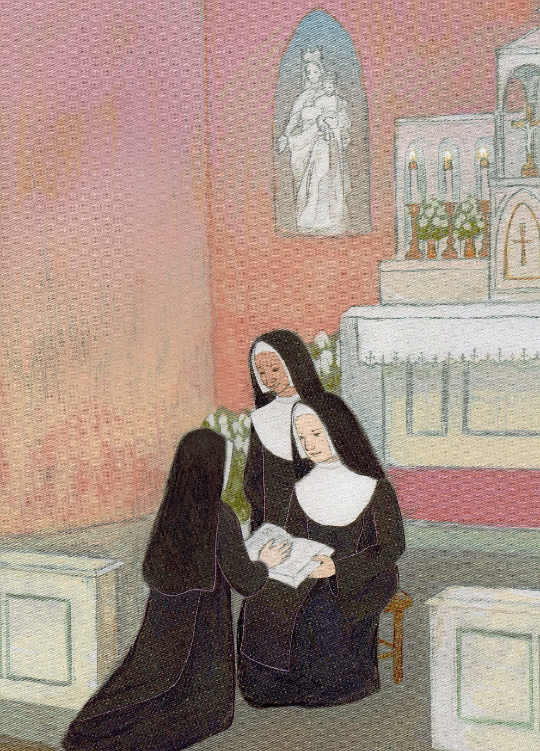
Yes, Lord, I will be your Servant.

Slide 15
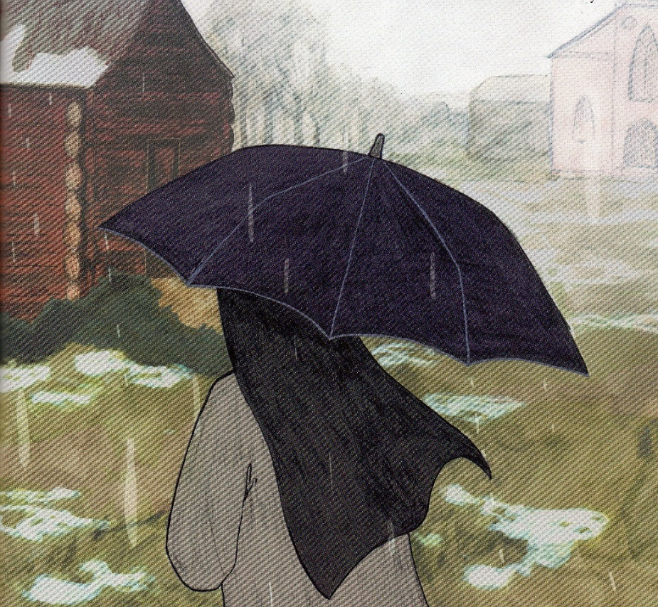
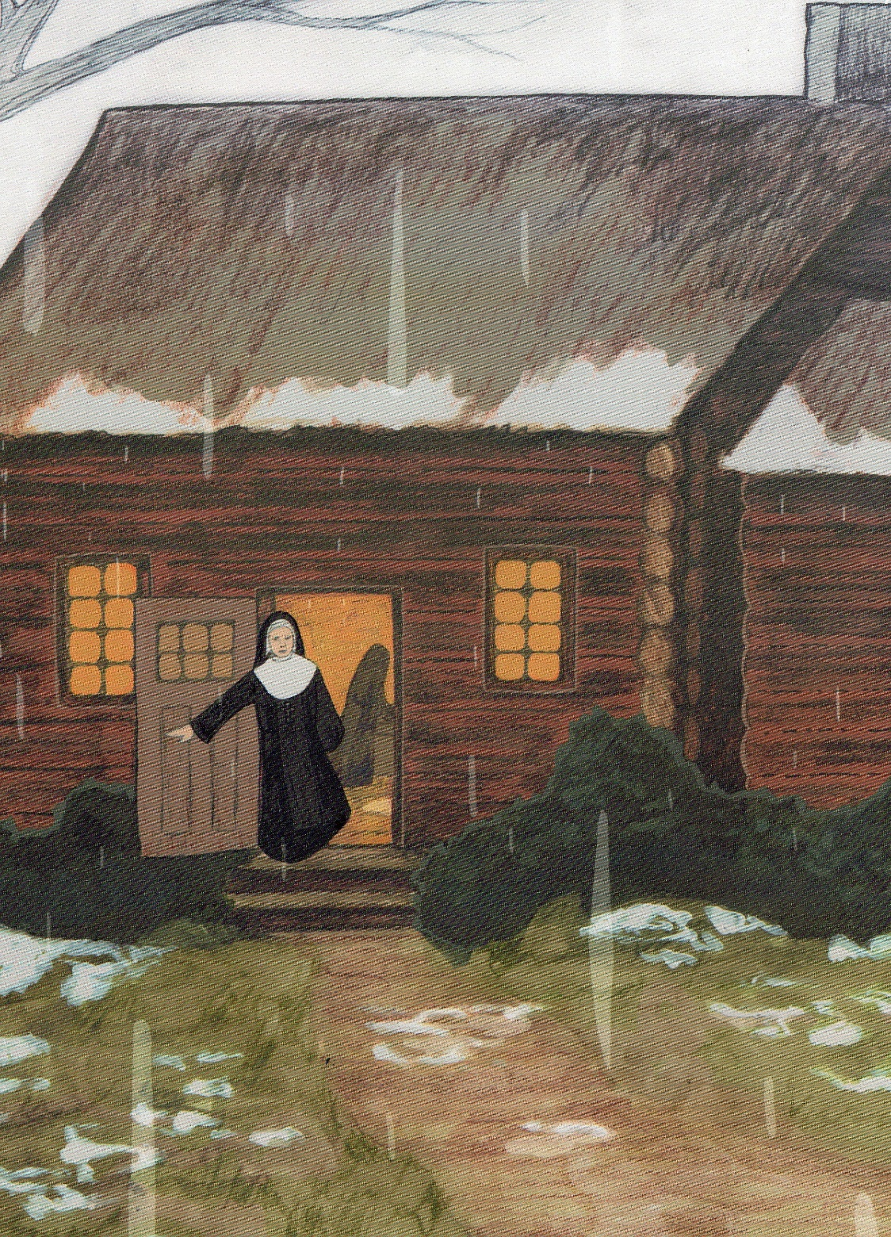
The first Winter was very cold and snowy. They had to cut a hole in the ice to get their water. Even though life was hard their hearts were happy and they laughed and enjoyed being together. Joyful Service is one of our characteristics. That´s why we are called Sister Servants.

Slide 16
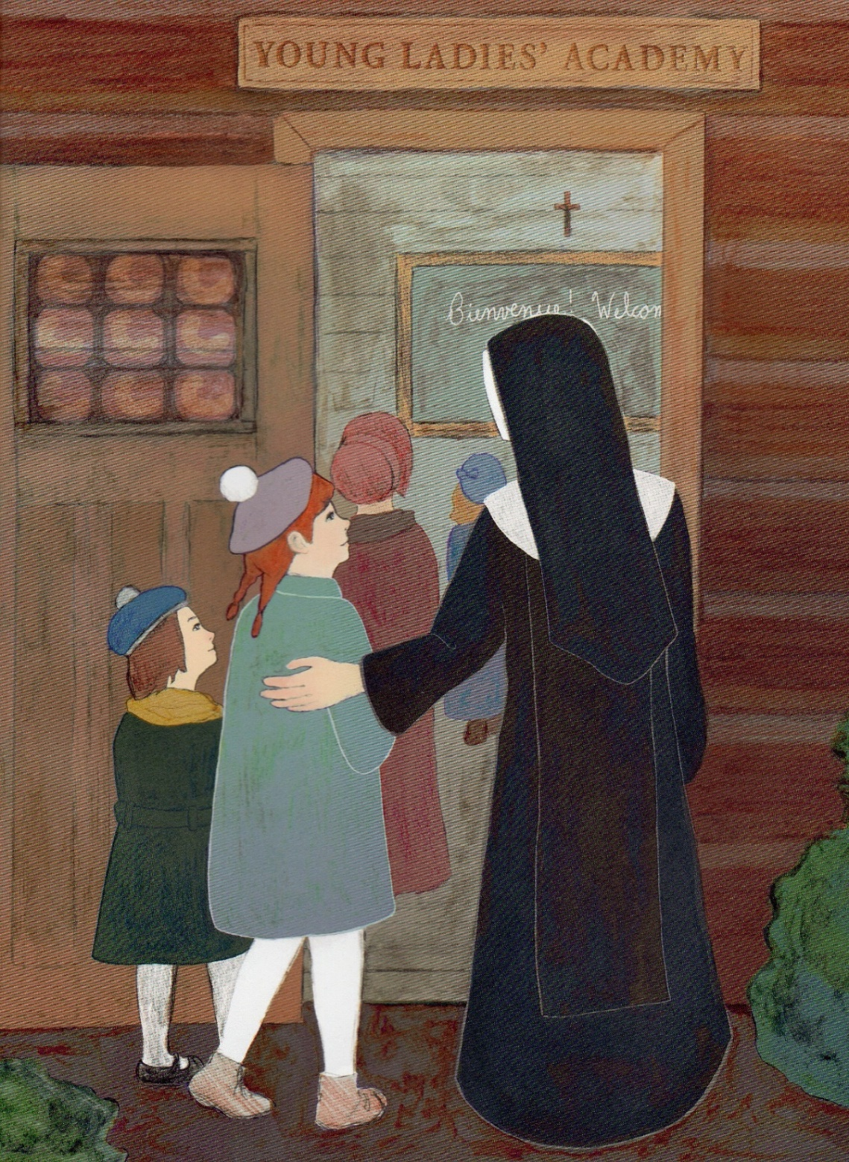
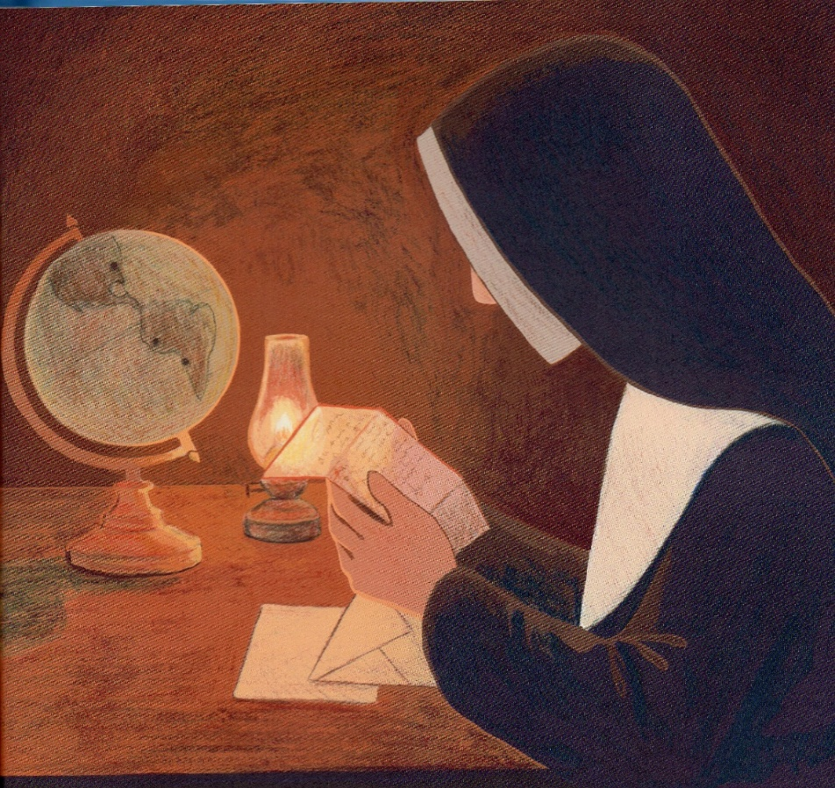
Bishop John Neumann wrote a letter
to Mother Teresa and asked for sisters for the schools in Pennsylvania.
5 sisters went
and the community grew.

Slide 17
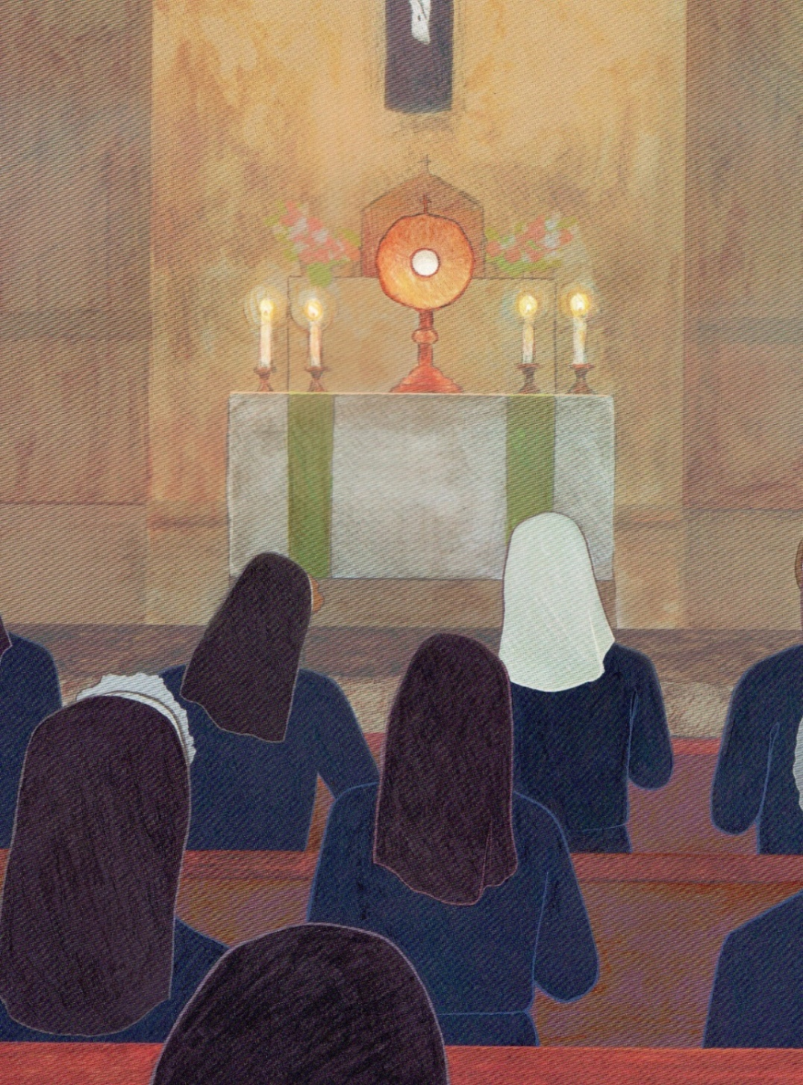
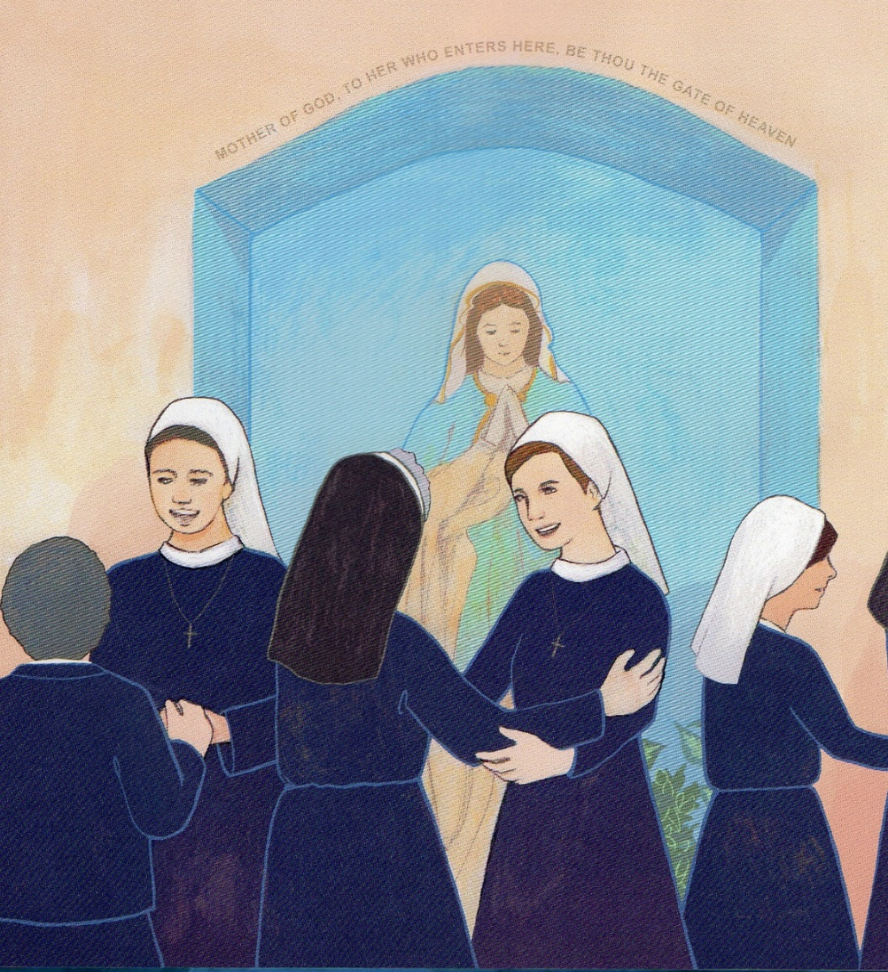
Young women continue
to join us
in our
Joyful
Service
of God
and
God’s people.

Slide 18
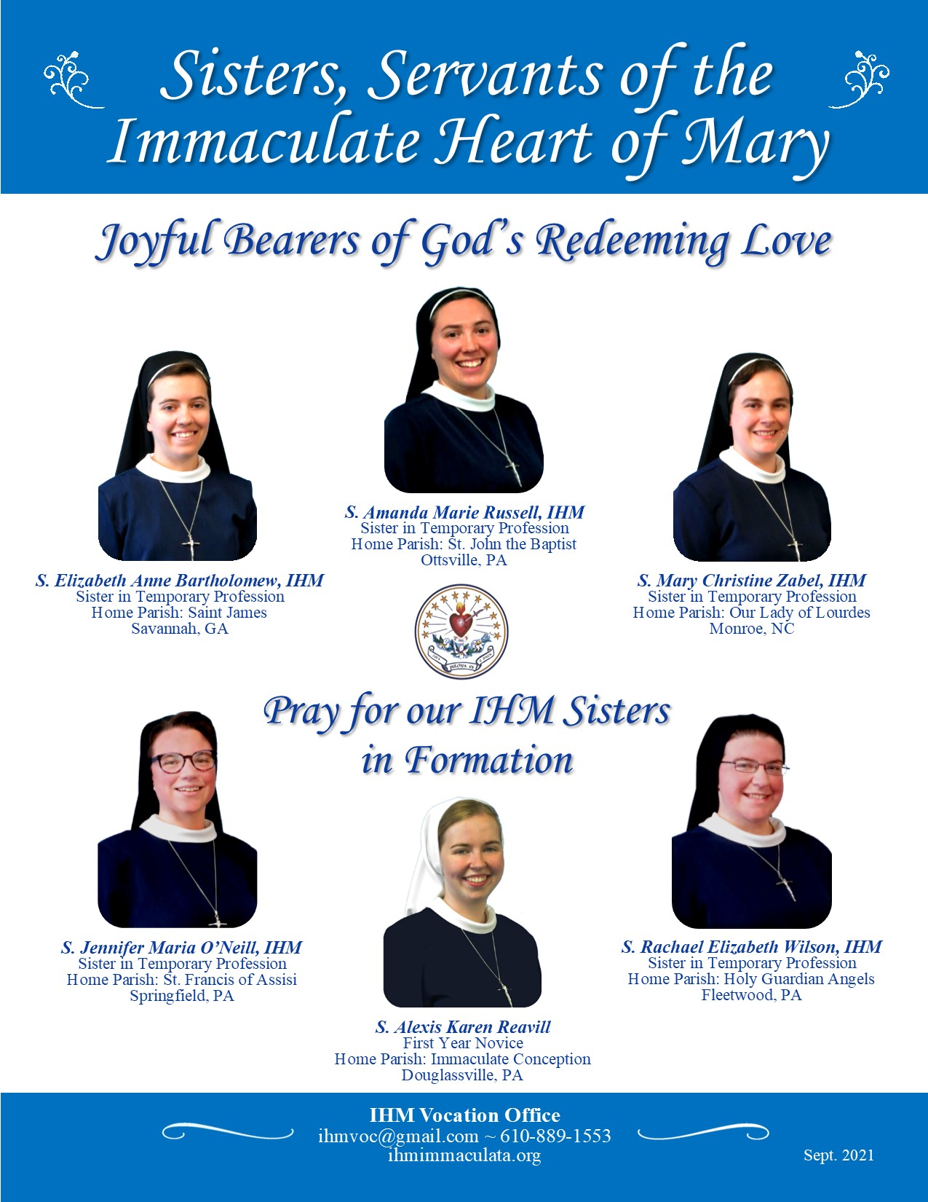
Are you calling me, Lord, to be a Sister, Servant
of the Immaculate Heart of Mary?

Slide 19
Find out more about IHM vocations:
http://www.ihmvocations.org
Find out more about the IHM Sisters:
http://www.ihmimmaculata.org
Contact the IHM Vocation Office:
Sister Marianne Therese Lallone, IHM
ihmvoc@gmail.com

